Slide 1
Parent Orientation Meetings
Nov. 16, 2023

Slide 2
Introduction:
Associate Director of Missions
Oversee the Church and Pastoral Ministries
GCA = 100 Member Churches
3 Regions & Regional Directors
North: Harrison Chang
Central & Hispanic: Santiago Rodriguez
South: Chris Smith

Slide 3
Project NEED:
Students are capable & gifted to serve now
High School years are a crucial time
Many churches are small
Gen Z is experiencing great challenges with identity, Internet & Social Media
Many stop attending church in college

Slide 4
Project PURPOSE:
The purpose is for selected GCA high school students to engage Missional Living through a Mission Exploration Process.
Desired outcome: For students to see themselves as Great Commission Missionaries.

Slide 5
Project TARGET:
A select group of 25-30 high school students from GCA churches.

Slide 6
Project Target:
Selection Process:
Two students from one church
Must complete application process on time
Upper Graders are given priority
Open for more if space is available

Slide 7
Project Objectives: STUDENTS
(Mind) To discover their calling and capacity for the Kingdom Work
(Spiritual) To encounter Jesus through active missional engagement
(Ultimate) To covenant with the missional community to live out their calling

Slide 8
Theological Rationale: Biblical
God has created, redeemed, and called each student for His kingdom purposes.
Students need experiential knowledge of their faith.
God has commissioned all believers to the Great Commission.

Slide 9
Theoretical Rationale: Practical
All Students can serve the Great Commission Now.
High school years (Ages 14-18) are crucial for future career path and life impact.
Students learn best in Physical, Emotional, and Socially Immersive settings.

Slide 10
Project Approach: Mission Exploration process
Kickoff Retreat
(April 26-28, 2024)
Online Sessions
(May 2024)
Mission Project (June 21-29, 2024)
One-on-One Debrief (June 2024)

Slide 11
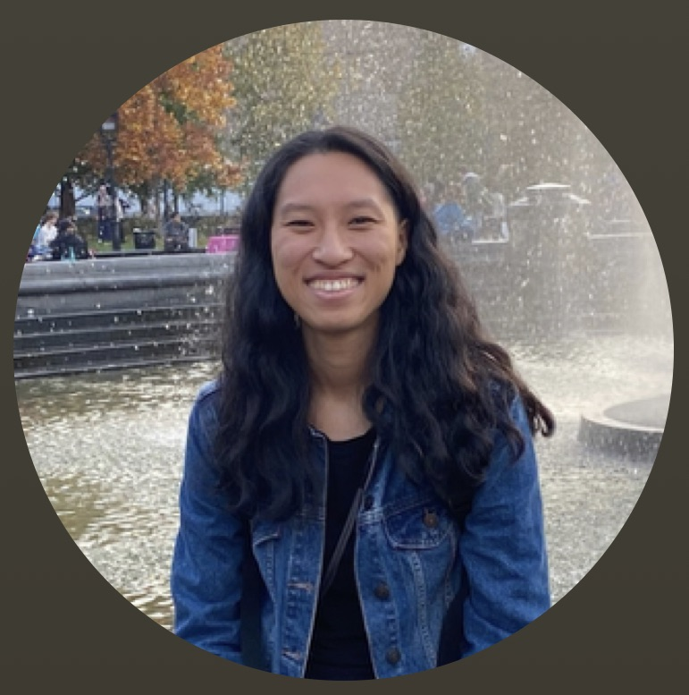
Project Leaders
Melodie Sun
Youth and English Ministry Leader @ Ark Baptist Church
Pending

Slide 12
1. Kickoff Retreat
Goal: Building a Missional Community
Date: April 26-28, 2024
@ Camp Santa Cruz
Worship, Praise and Fellowship
Team competition for Skits
Sharing testimonies and life stories
Beach Bonfire
Other

Slide 13
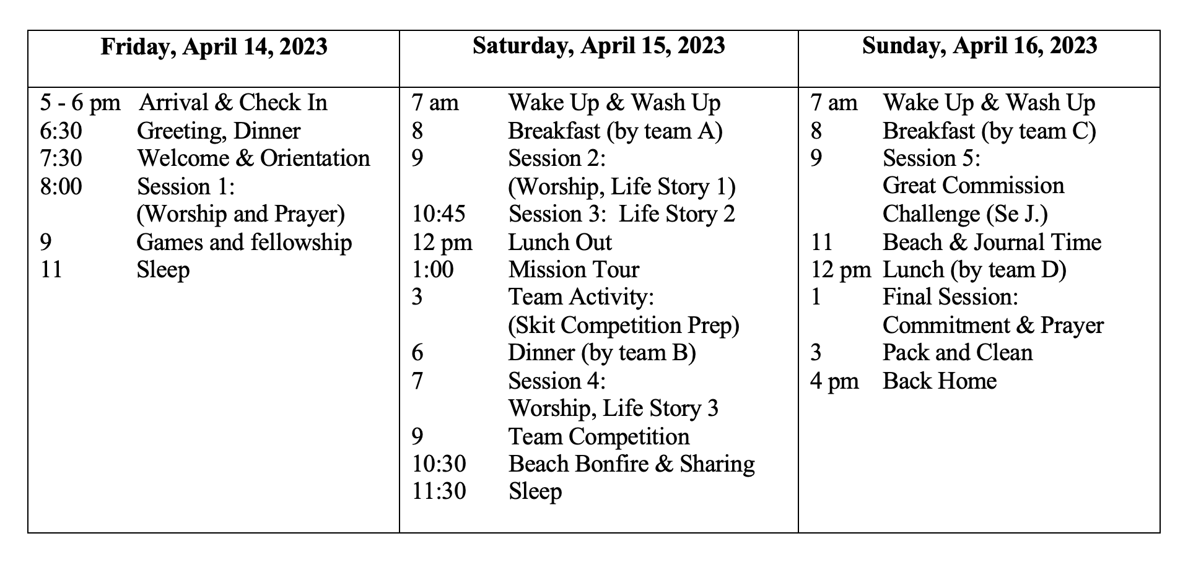
Kickoff Retreat (April 26-28, 2023)
Friday, April 26, 2024
Saturday, April 27, 2024
Sunday, April 28, 2024

Slide 14
2. Online Sessions (May 2023)
Three Parts
Learning Session
Hearing from SBC Leaders
Mission Project Planning Preparations

Slide 15
2. Online Sessions (May 2023)
Goal: Learning about God and Self
1) God’s calling on your life,
2) God has gifted you for His glory,
3) Trusting God through stages of life
4) Spiritual Disciplines for Growth.

Slide 16
Mission Engagement Project
Goal: Gaining Experiential Knowledge of Faith
Date: June 21-29, 2024
FBC Soldotna, Alaska
Examples: VBS, outreach, prayer walk, street evangelism, student rally, etc.
Potentially do a Mission Tour

Slide 17
Mission Project (June 15-18, 2023)
Schedule Pending Final Project Details with FBC Soldotna.

Slide 18
One-on-One Interview
Goal: Reflecting on the SMEP Experience
Month of June & July
Feedback & evaluation of their experience
Exit Interview for Reflection

Slide 19
2nd Class, 2024
SMEP Commemorative Coin for those who Finish

Slide 20
2nd Class, 2024
SMEP Commemorative Coin: Future opportunities
Future GCA mission projects,
Student rallies,
Youth conferences, and
International mission trips
Serve as Project leaders
Student Ministry Interns

Slide 21
Project Budget
 |  | Per/Participant | Quant. | Total
1 | Retreats & Project Lodging | $400 | 25 | $10,000
2 | Materials (assessment, books, etc.) | $50 | 25 | $1,250
3 | Mission Project Fee | $1500 | 25 | $37,500
4 | Misc.: Tour, Guests, Gifts, Fun Day, etc. | $150 | 25 | $3,750
5 | Honorarium & Scholarship | $300 | 25 | $7,500
 | Total Expenses | $2400 | 25 | $60,000
1 | Parents Support | $150 | 25 | $3,750
2 | Church Support | $150 | 25 | $3,750
3 | Mission Fund Raised | $1500 | 25 | $37,500
3 | Partner Support (CSBC, IMB, Baptist Foundation, others) | $300 | 25 | $7,500
4 | GCA Support | $300 | 25 | $7,500
 | Total Income | $2400 | 25 | $60,000

Slide 22
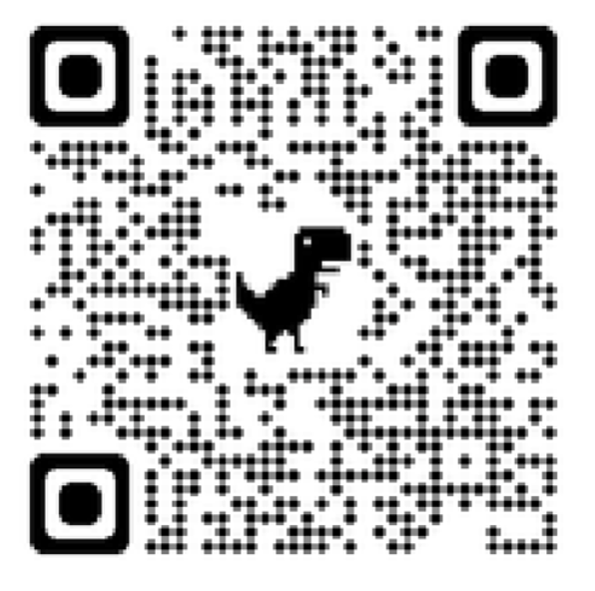
REQUESTS & Q&A
Prayer for SMEP and the Gen Z
Apply Online:
Permission from Parents
Endorsement from Pastor
Student Application
Participant Agreement
Email sej.won@gcasbc.org or Contact Se J. (408) 569-7147 for any questions.
Questions or Comments

Slide 23
Application Dates & Schedule
SMEP Orientation: Nov. 16, 2023 (7pm)
Application Deadline: Jan. 31, 2024
Applicant Interview: Feb. 2024
Kickoff Retreat: April 26-28, 2024
Online Sessions: May 2024
Mission Project: June 21-29, 2024

